Slide 1
CP5804 Week 4
Assessment 2: Normalisation
DUE Sunday 5 April 11:59PM AEST
Assessment 4C: Week 4 Lab – importing data into MySQL
DUE Sunday 5 April 11:59PM AEST

Slide 2
Relational algebra
Mathematical operations on relations (sets of tuples)
Theoretical foundation for SQL, but not exactly the same
Selection
Projection
Product
Division
Union
Intersection
Difference
Joins

Slide 3
Selection & Projection
Selection on a relation yields a subset of the rows of the relation according to some condition
Projection on a relation yields a subset formed by taking only specific columns
SQL provides a SELECT statement that performs both SELECT <columns> FROM <table> WHERE <condition>

Slide 4
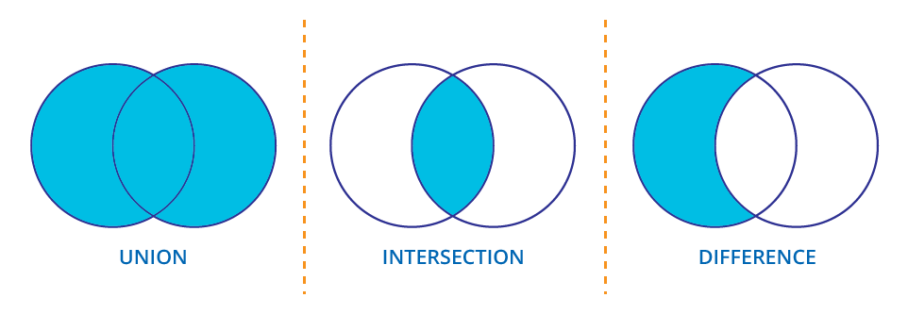
Union, Intersection, and Difference

Slide 5
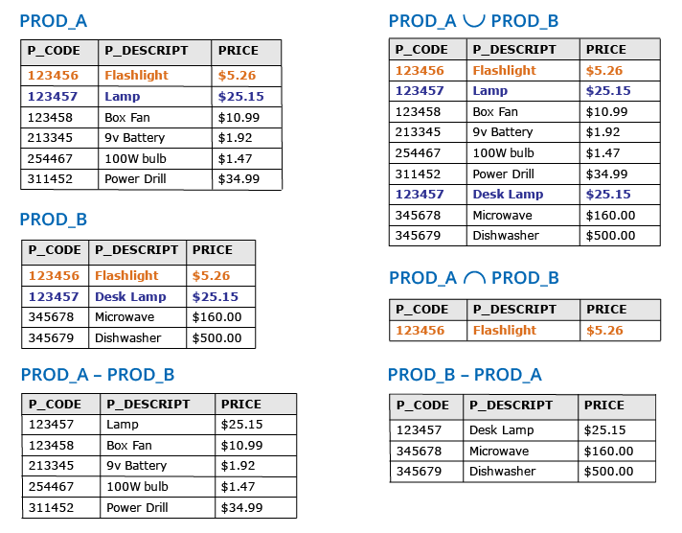
Union, Intersection, and Difference

Slide 6
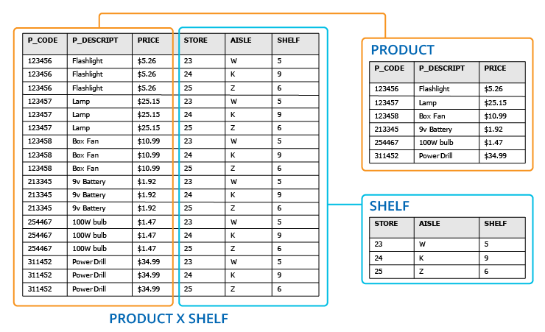
Cartesian Product

Slide 7
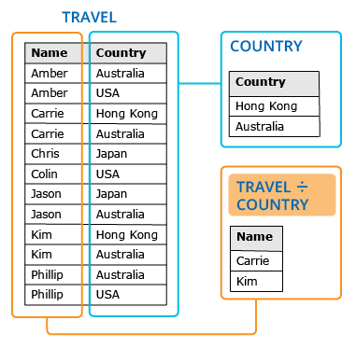
Division

Slide 8
Joins
Create new relations join tuples from two relations together
Logically the same as a select from the Cartesian product of two relations
Theta-join can use any condition to join relations
Equi-join joins where two attributes are equal
Natural join joins relations where there are equal values in common attributes and projects to remove duplicate columns
Outer joins keep unmatched tuples

Slide 9
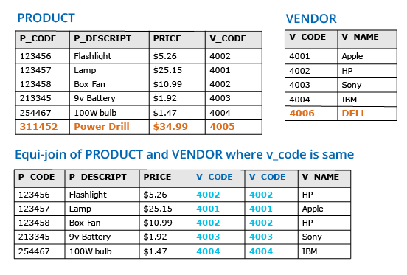
Equi-join

Slide 10
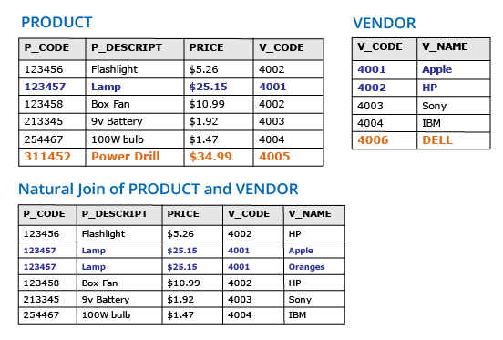
Natural Join

Slide 11
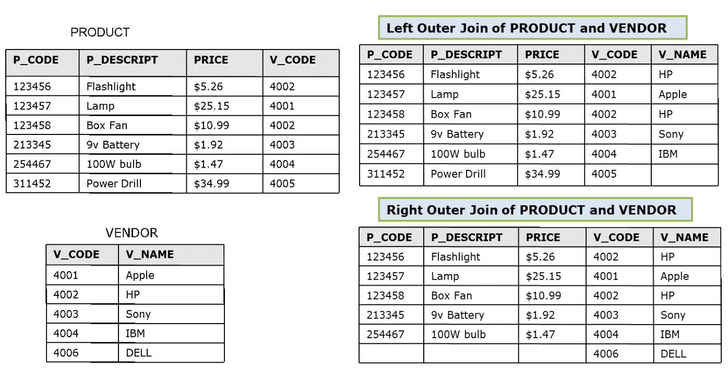
Left and Right Outer Joins

Slide 12
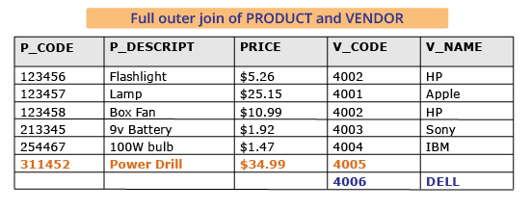
Full outer join

Slide 13
SQL Data Definition
COMMAND OR OPTION | DESCRIPTION
CREATE SCHEMA | Creates a database schema
CREATE TABLE | Creates a new table in the user's database schema
NOT NULL | Ensures that ac olumn will not have null values
UNIQUE | Ensures that a column will not have duplicate values
PRIMARY KEY | Defines a primary key for a table
FOREIGN KEY | Defines a foreign key for a table
DEFAULT | Defines a default value for a column (when no value is given)
CHECK | Validates data in an attribute
CREATE INDEX | Creates an inde for a table
CREATE VIEW | Creates a dynamic subset of rows and columns from one or more tables (see Chapter 8, Advanced SQL)
ALTER TABLE | Modifies a table's definition (adds, modifies, or deletes attributes or constraints)
CREATE TABLE AS | Creates a new table based on a query in the user's database schema
DROP TABLE | Permanently deletes a table (and its data)
DROP INDEX | Permanently deletes an index
DROP VIEW | Permanently deletes a view

Slide 14
SQL Data Manipulation
INSERT | Inserts row(s) into a table
SELECT | Selects attributes from rows in one or more tables or views
WHERE | Restricts the selection of rows based on a conditional expression
GROUP BY | Groups the selected rows based on one or more attributes
HAVING | Restricts the selection of grouped rows based on a condition
ORDER BY | Orders the selected rows based on one or more attributes
UPDATE | Modifies an attribute's values in one or more table's rows
DELETE | Deletes one or more rows from a table
COMMIT | Permanently saves data changes
ROLLBACK | Restores data to its original values

Slide 15
SQL Data Manipulation
Comparison operators
=,<,>,<=,>=,<>,!= | Used in conditional expressions
Logical operators
AND/OR/NOT | Used in conditional expressions
Special operators
BETWEEN | Checks whether an attribute value is within a range
IS NULL | Checks whether an attribute value is null
LIKE | Checks whether an attribute value matches a given string pattern
IN | Checks whether an attribute value matches any value within a value list
EXISTS | Checks whether a subquery returns any rows
DISTINCT | Limits values to unique values
Aggregate functions
COUNT | Returns the number of rows with non-null values for a given column
MIN | Returns the minimum attribute value found in a given column
MAX | Returns the maximum attribute value found in a given column
SUM | Returns the sum of all values for a given column
AVG | Returns the average values for a given column

